Slide 1
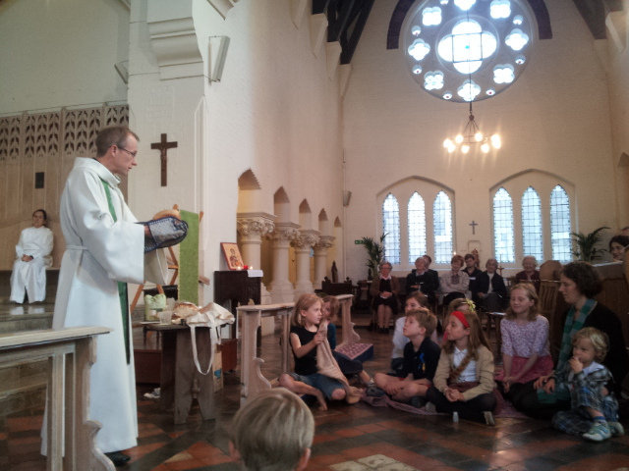
All-Age Worship at Festivals
Margaret Pritchard Houston
Children’s worker and author

Slide 2
Why festivals?
Highlight of the year – most important stories
Children who don’t come at other times

Slide 3
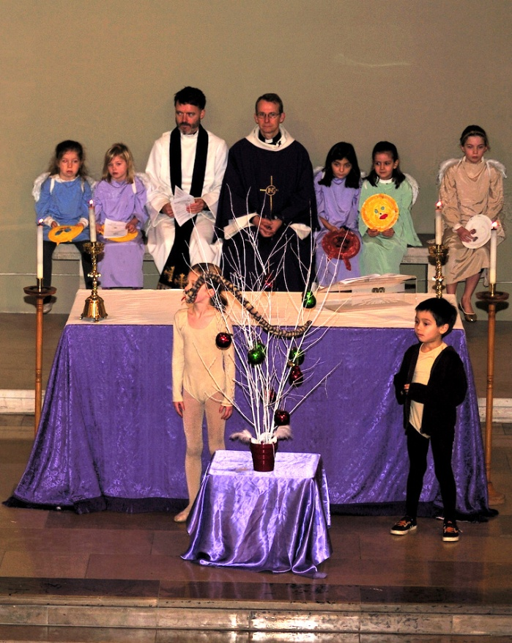
WHAT are we celebrating? (theology)
HOW can we celebrate it? (liturgy)

Slide 4
What are the key images, symbols and themes of the festival?
What are the sensory possibilities for your chosen festival? Think smell, touch, taste, light, sound, colour, movement ...
Harvest
All Saints/All Souls
Christmas
Candlemas
Mothering Sunday
Palm Sunday
Maundy Thursday
Good Friday
Great Vigil of Easter
Easter Sunday
Pentecost

Slide 5
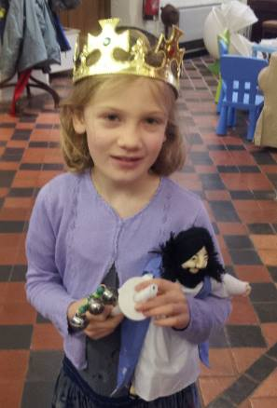

Slide 6
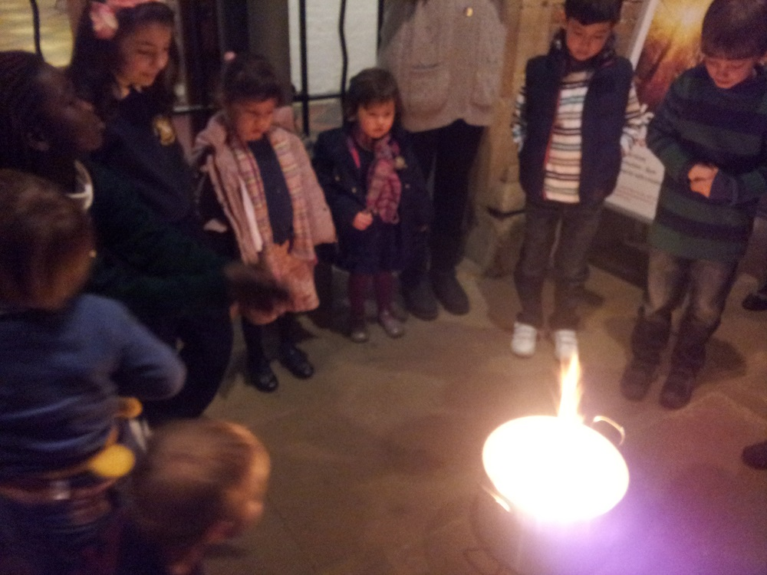

Slide 7
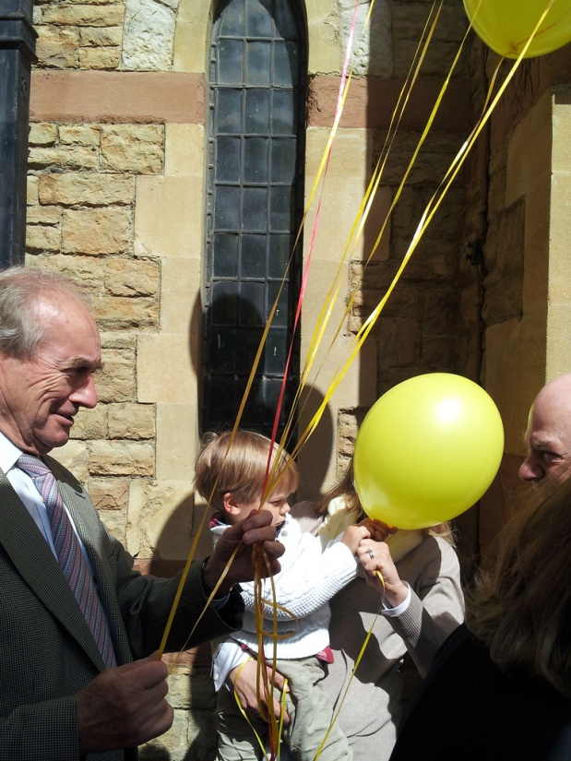

Slide 8
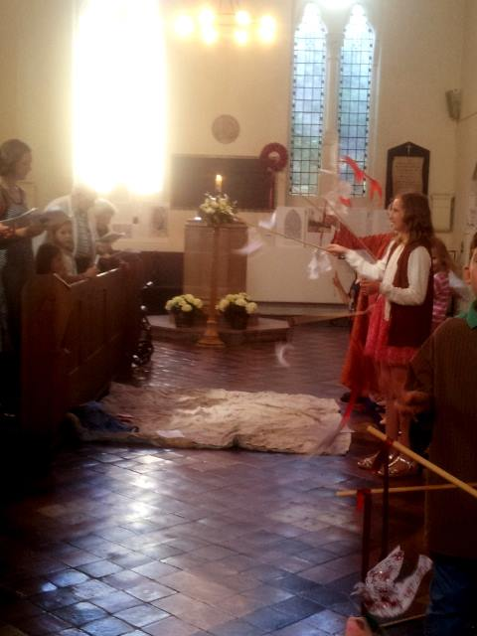

Slide 9
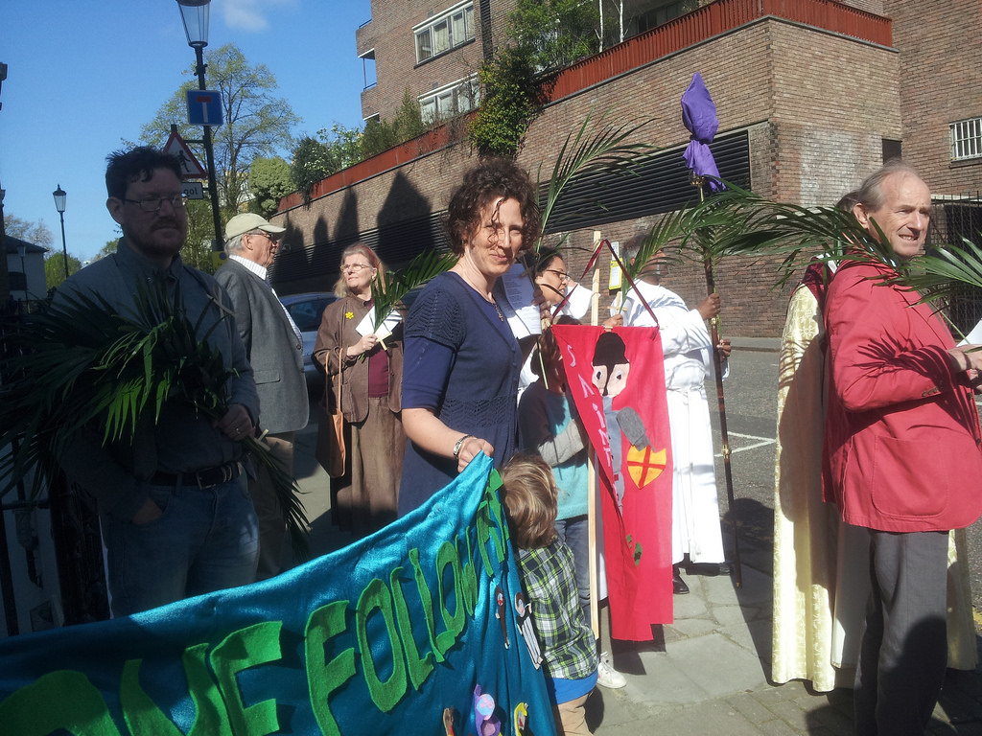

Slide 10
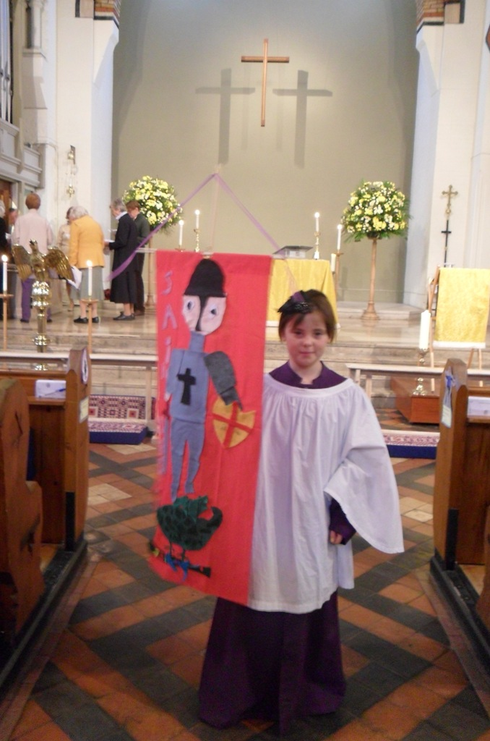

Slide 11
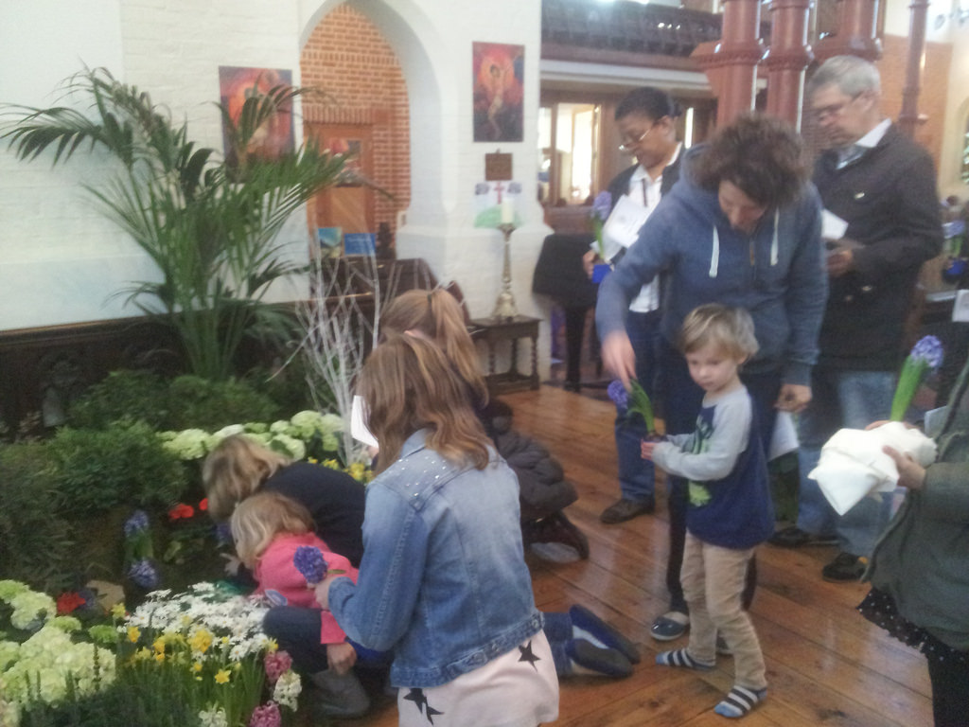

Slide 12
Sensory possibilities and key images provide foundation and direction.
Models of worship → HOW

Slide 13
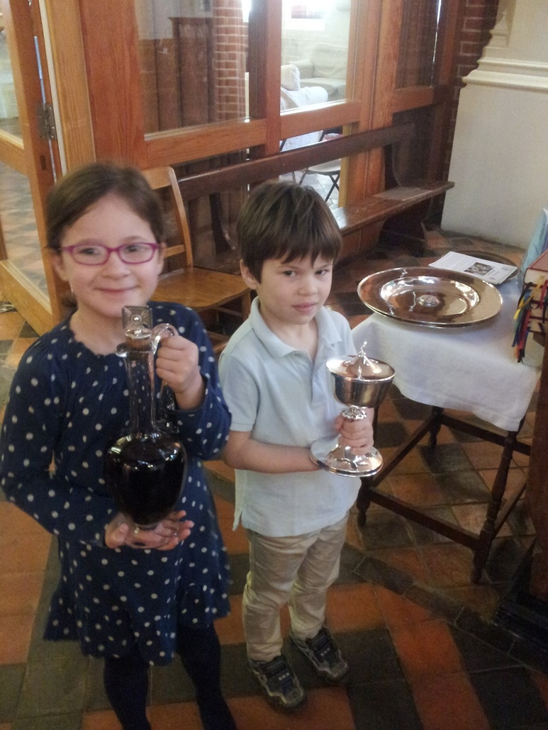
Standard Eucharistic model:
Gathering
Hearing the story
Responding to the story
Prayer
Sharing communion
Sending out

Slide 14
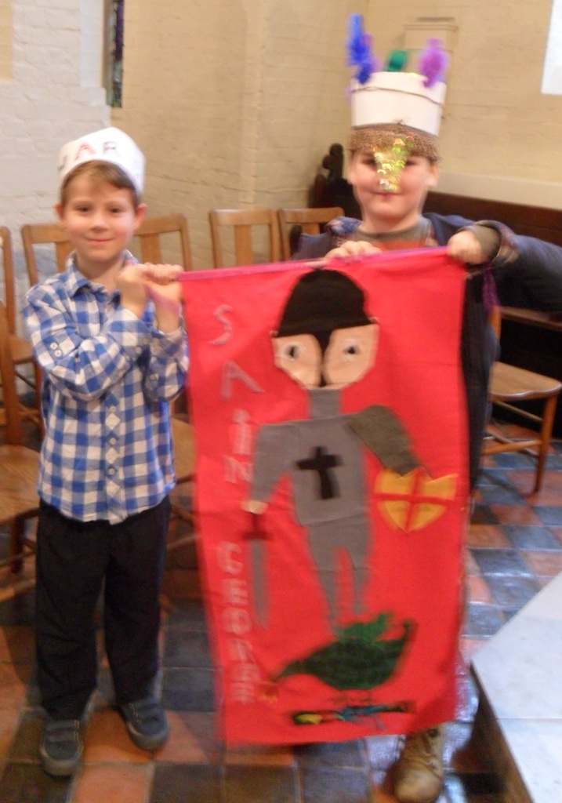
3 Ps Model:
PREPARATION
PRESENTATION
PROCESSING

Slide 15
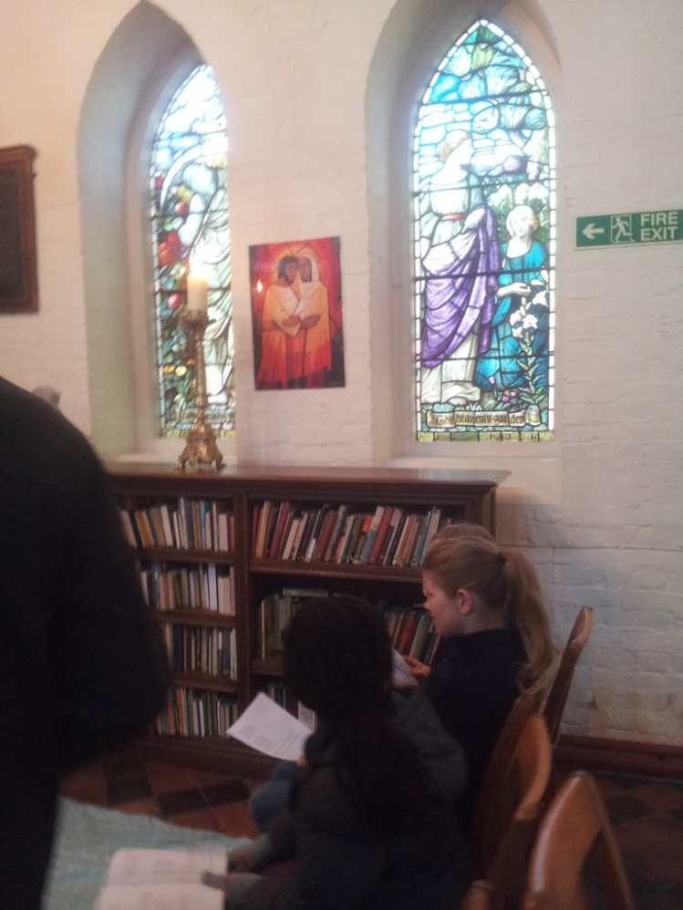
Cycle Model:
Repeating the same format at different stations, or for different stories.

Slide 16
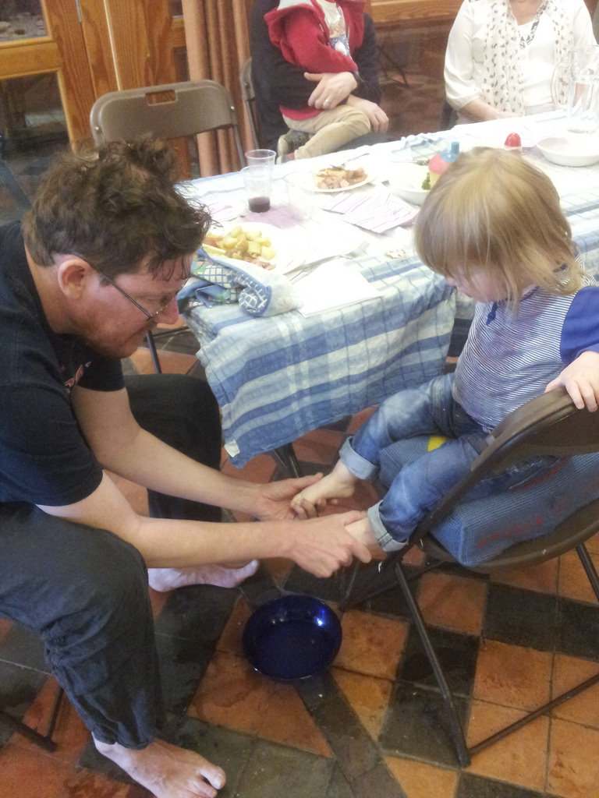
Journey Model:
Starting in one place and physically moving to different places as you tell the different parts of the story.
Like the Cycle model, only the experiences at the different stations may be different, while the Cycle model repeats itself.

Slide 17
Planning your own:
1) Use your sensory possibilities and key images.
2) Choose a model of worship
Questions to guide planning:
Where will you begin?
How will you use your sensory ideas? How will the key images and symbols you’ve chosen emerge throughout the service?
What opportunities are there for children to LEAD the worship – write the prayers, act out or tell the story, sing an anthem?
What about children who haven’t been to church before? How will you help them understand what’s happening and why it matters?
Don’t worry about what music you’ll use, or what prayers, unless you already have clear ideas. You can figure that out later.

