Slide 1
Worship Wardrobe
Mary Hawes
National Going for Growth (children & youth) Adviser
Church of England

Slide 2
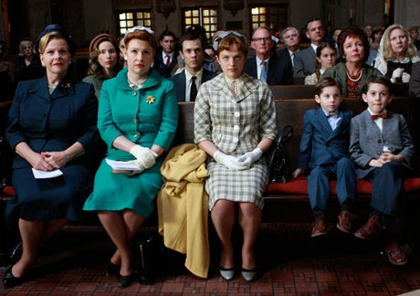
Sunday best?
Notes:
I prefer to cut children’s spiritual garments a little too large for them to grow into, as they will in time. And who knows what vivid image or hint of the beauty of God will remain in their mind and memory?
Dorothy Coddington, 1923

Slide 3
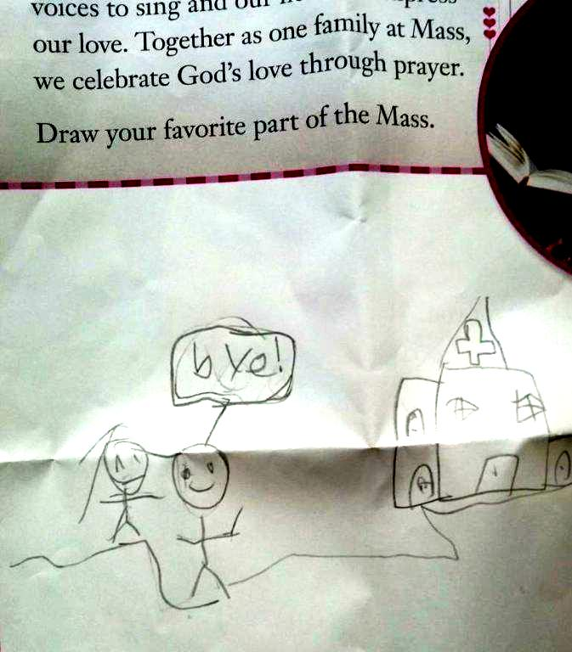
The best part of Mass

Slide 4
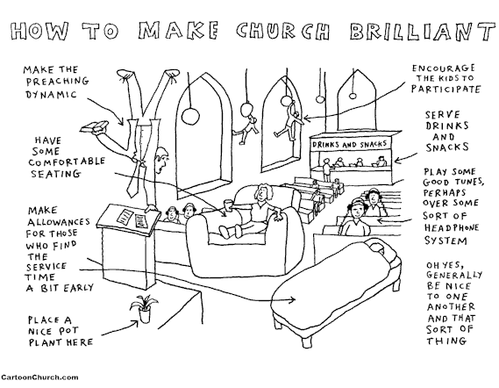

Slide 5
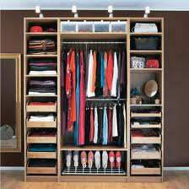
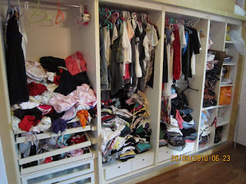
A wardrobe of possibilities
Things I remember from ordination training
Common Worship
Stuff that might come in useful
BCP
Good ideas I read on the Internet
Eucharistic prayers
Feasts and Festivals
Visual aids
Music of all kinds
Interactive prayers

Slide 6

Dress for your shape

Slide 7
The shape of worship
Gather
Listen
Respond
(Celebrate)
Go out

Slide 8
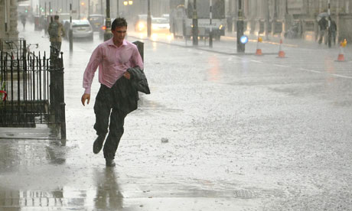
Dress for the occasion

Slide 9
The occasion of worship
Eucharistic
Service of the Word
School service
Toddler Praise
…….

Slide 10
Creating an outfit
Foundation garments
  Common Worship, shared texts/music
A variety of outfits
  Context, congregation
Accessories galore
  Pulling it all together
Find your style
  Wear it well

Slide 11
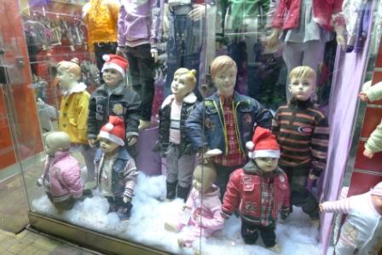
Not for dummies

Slide 12
An holistic experience
Body
Spirit
Mind
Notes:
The children and adults will be there in body – our task is not only to engage their bodies, but their minds and spirits as well

Slide 13

Not everything at once!

Slide 14
A Capsule Wardrobe
  shape
  texts
  prayers
  music
  symbols
  gestures
  people

Slide 15
The Lord is here!
Crossing the threshold
Ordinary space used for an extraordinary purpose
Seating arrangements
Focal point(s)
Familiarity with space

Slide 16
Engage the senses
Sight
Sound
Touch
Taste
Smell
Awe and Wonder

Slide 17
Purposeful movement
Posture
Gesture
Processing
Kinaesthetic prayer

Slide 18
The Sound of Music
Creating atmosphere/expectation
Music and prayer
Musical responses
Aiding reflection
Links between school and church
Familiar, new, heritage
Making music

Slide 19
The Sound of Silence
Not an absence of sound
Intentional
Visual and verbal focus
Space for reflection
Use of lighting

Slide 20
More than Amen
Composers of liturgical material
Musicians
Cantors
Readers
Intercessors
Acolytes
Sacristan
Presenting drama
Welcomers
Worship planners
Technicians

Slide 21
Dressing for the season
Advent/Lent
Christmas/Easter
Saints’ Days/Patronals
Use of focal table/display

Slide 22
Spring-cleaning
Clarity not clutter
Simplicity not simplistic
Engaging not entertainment
Thought through not thrown together
Inclusive not imposed
Neither dense nor diluted
Culture and community
Sense of celebration

Slide 23
Fit for purpose…..
Focus - God
Frequency – weekly? Termly? Seasonal?
Themes – Lectionary? Church-driven? School-driven?
Receiving – Communion? Blessing?
Participation – For? Among? By? With?
Process not Product – Before, during, after
Patterns of worship – Bridges, Models, Transferable

Slide 24
One more thing……
If it’s dependant on the presence of children
it isn’t all age worship

Slide 25
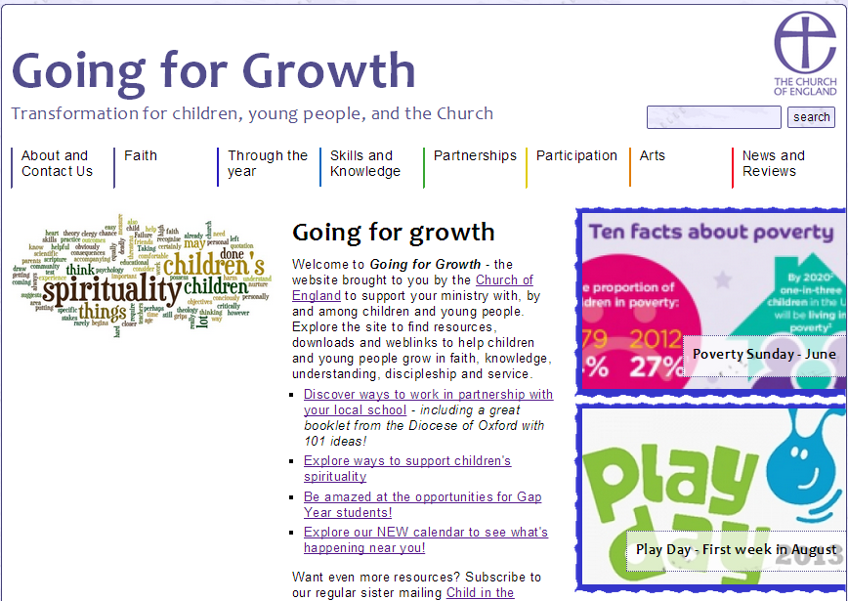
Worship ‘outlets’
www.going4growth.org.uk

Slide 26
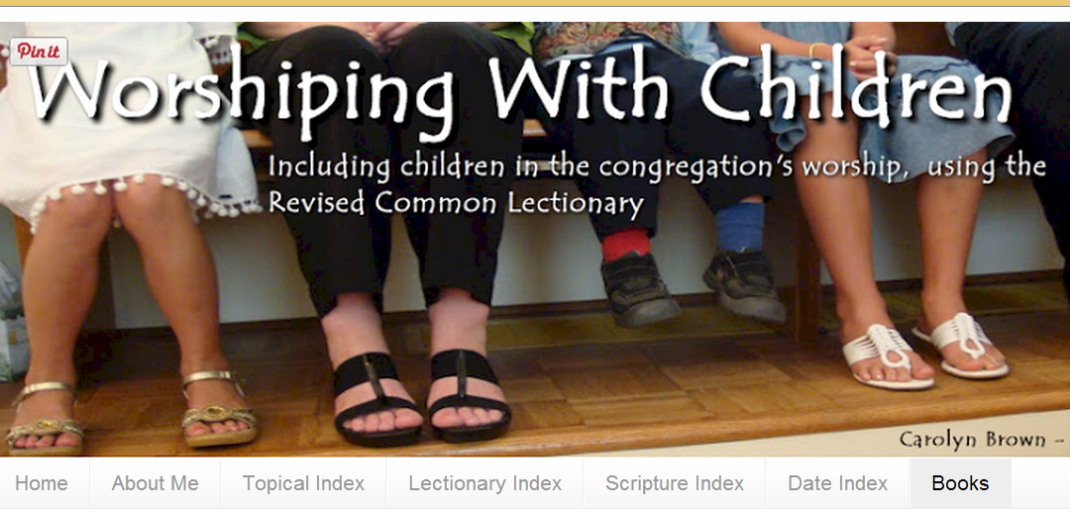
Worship ‘outlets’
www.worshipingwithchildren.blogspot.co.uk
http://worshipingwithchildren.blogspot.co.uk/

Slide 27
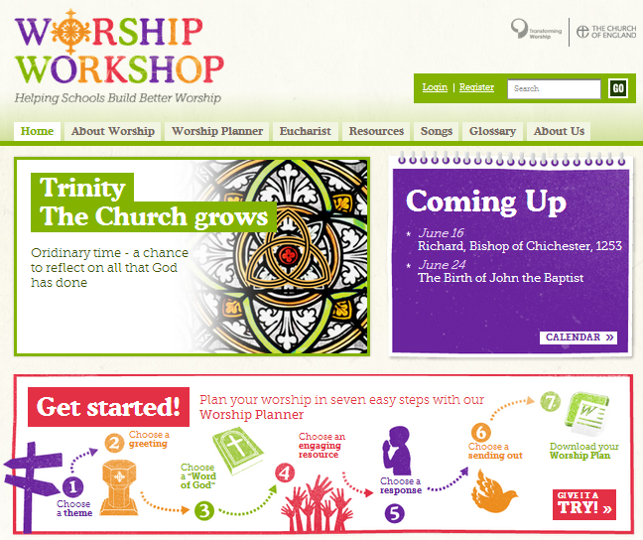
Worship ‘outlets’
www.worshipworkshop.org.uk

Slide 28
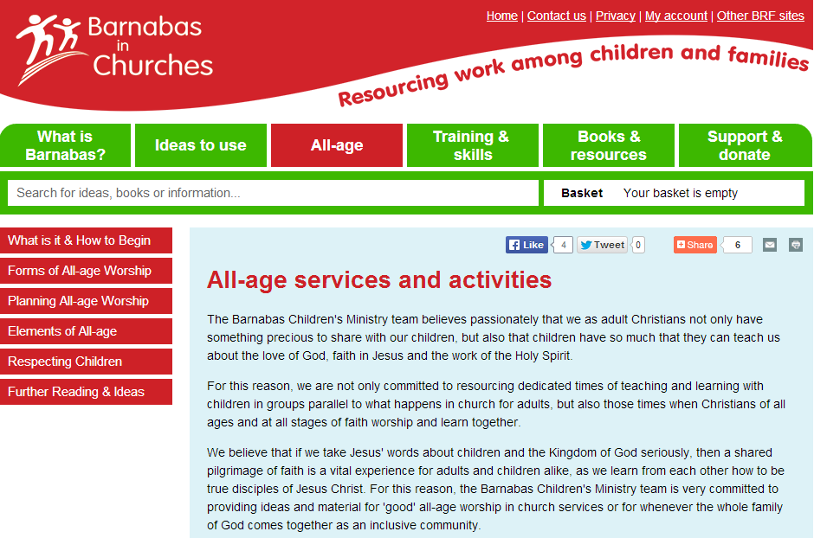
Worship ‘outlets’
www.barnabasinchurches.org.uk

Slide 29
Texts do not a service make
The Revd. Dr Angela Tilsby

